Slide 1
WELCOME TO GLASGOW ________________
Your introduction to the
Students’ Representative Council
Notes:
Hello! This presentation will give you an introduction to the Students’ Representative Council (SRC), the work we do to represent students, and the services we offer to students during their time at the University of Glasgow.
As a University of Glasgow student, you are automatically a member of the SRC and can freely access all our services!

Slide 2
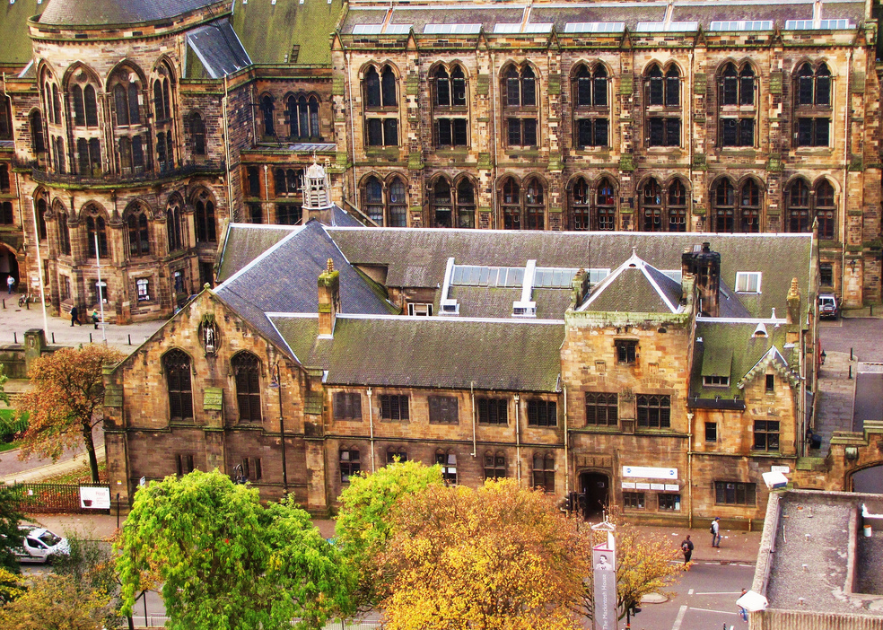
SRC Induction
We live in the McIntyre building at the bottom of library hill
One of the four student bodies here at Glasgow
The only representative body on campus
Notes:
We are based in the McIntyre Building – you can find our Welcome Point directly across from the Security Gatehouse at Main Gate. The Welcome Point is run by our friendly staff who are happy to answer any questions you have about campus!
There are four student bodies at the University – Glasgow University Sports Association (which manages the sports clubs on campus); Glasgow University Union and Queen Margaret Union (two social unions which you can join); and the SRC!
We are the only representative body on campus – this means that we have a legal responsibility to represent students, which we do by sitting on various university committees.

Slide 3
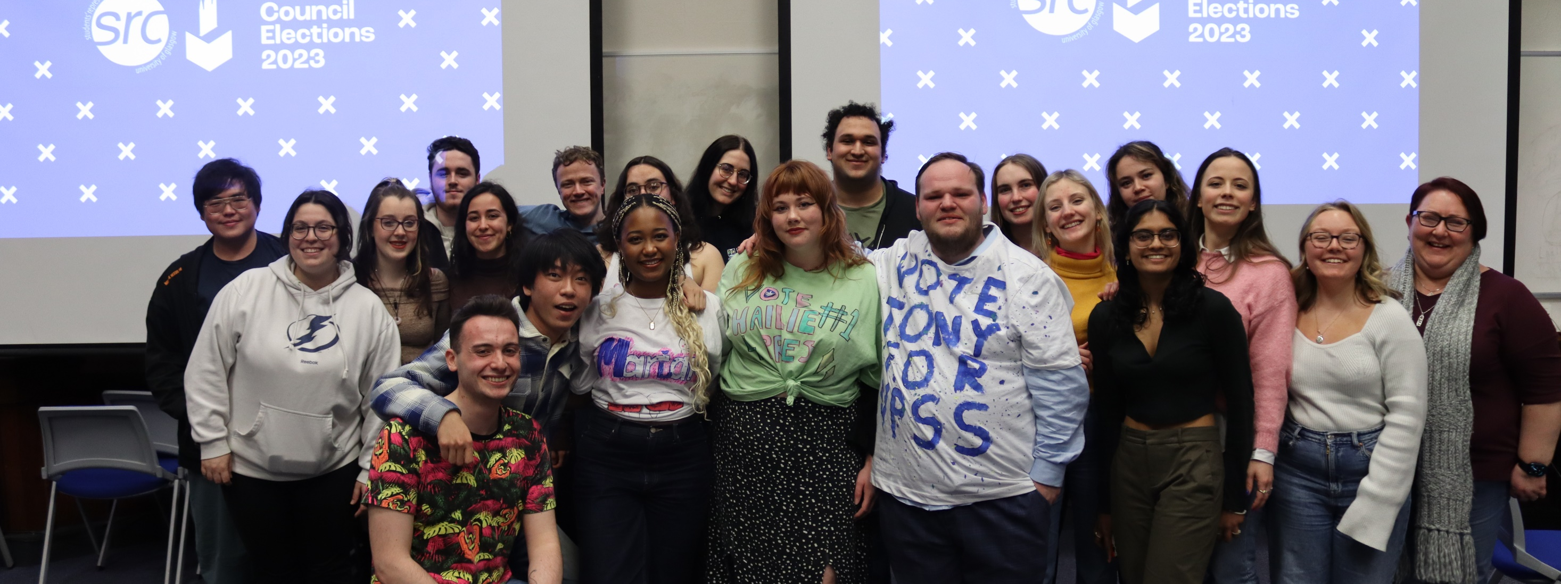
COUNCIL
50+ elected members representing the student body
Notes:
Another way we represent students is through our Council – a body made up of representatives elected by students!
We have three categories of representatives – general reps (made up of two first-year reps and four general reps); academic reps (made up of representatives from each school and college, as well as two postgraduate research reps), and welfare & equal opportunities officers (who represent students from often underrepresented backgrounds).
We also run campaigns throughout the year designed to raise awareness of, or bring about change concerning, issues which affect the student population.

Slide 4
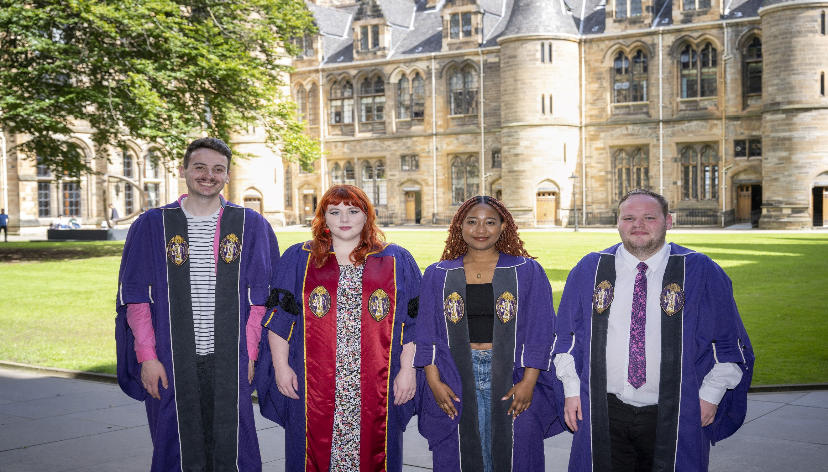
SABBATICAL OFFICERS
Notes:
The Sabbatical Officers are elected annually, and represent students on a variety of university-level committees. Each role is a year-long, full-time paid position.
Hailie, the President, is in charge of overseeing the SRC and normally takes the lead role in representing students to external organisations. She is also the public spokesperson for the SRC, including when providing comments to the media.
Mariama, the VP Student Activities, takes the lead in organising extra-curricular activities on campus. This includes organising Welcome Week and De-Stress events during exam periods. She also supports clubs & societies in her role.
Tony, the VP Student Support, represents students in committees relating to welfare. He also develops campaigns on issues which have an impact on the life of students at the University, as well as holding events for students from often marginalised backgrounds.
Ross, the VP Education, represents students on a variety of university committees related to academic issues. He also works closely with staff to develop and implement training for class representatives, and stays up to date on Higher Education related policies.

Slide 5
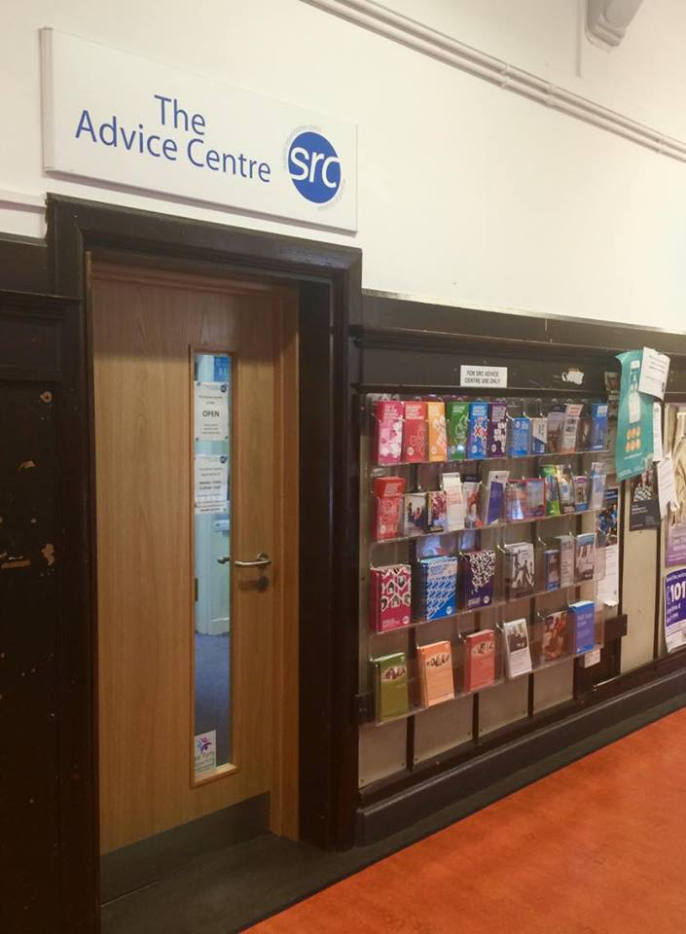
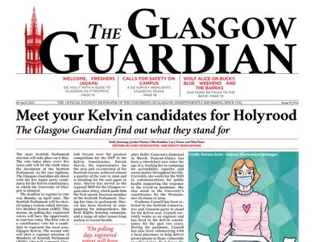
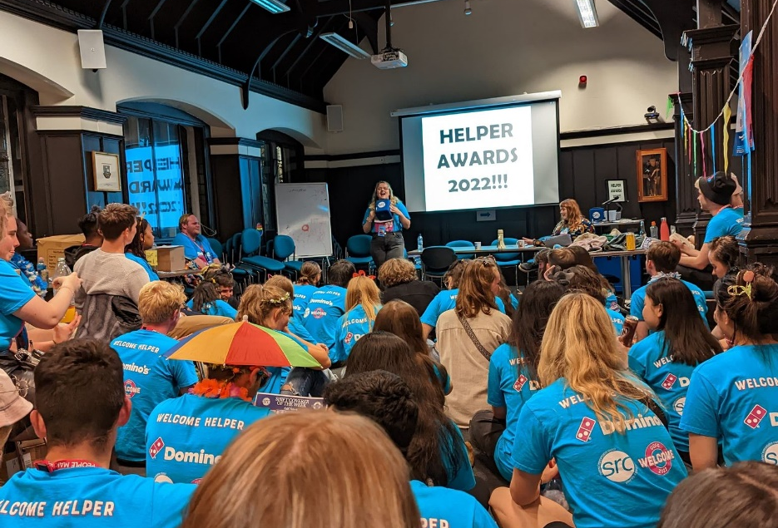
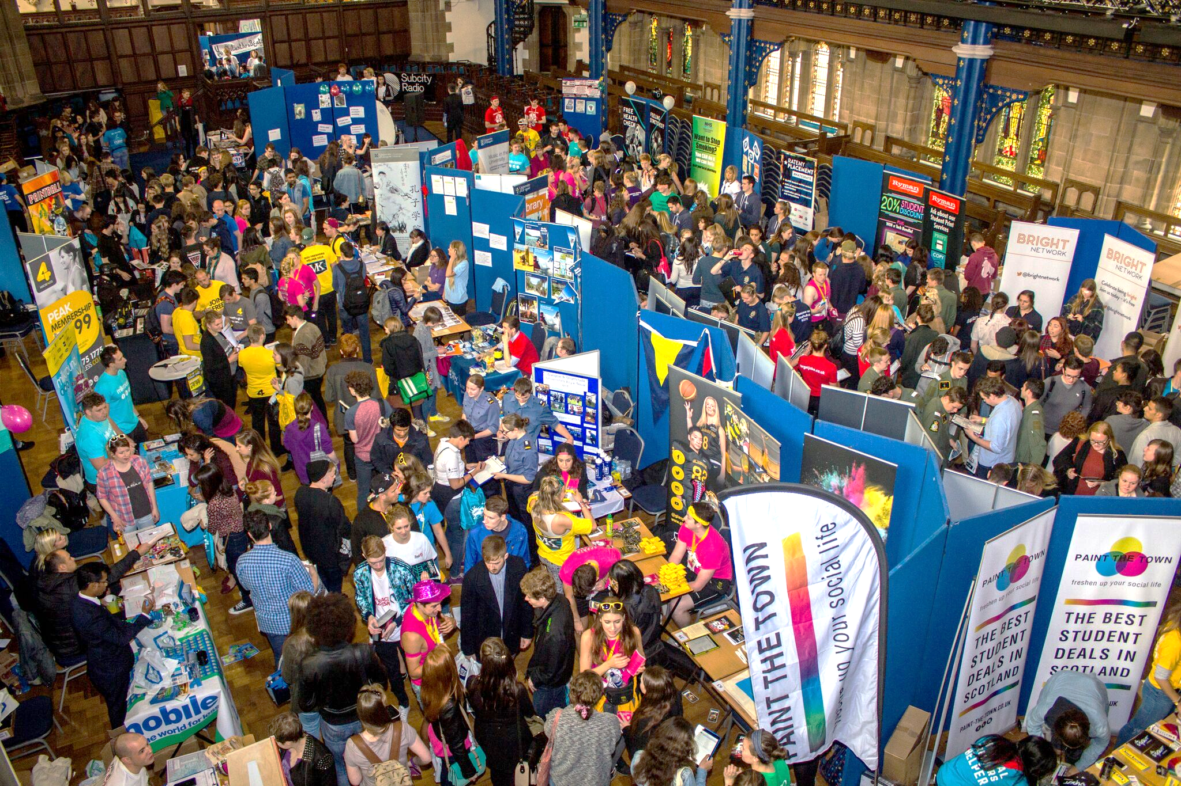
S
E
R
V
I
C
E
S
Notes:
The SRC offer a wide range of services which you can take advantage of during your time at the University of Glasgow:
Our dedicated Advice Centre offers free, independent, confidential advice on a range of issues related to student life – such as finance, employment and accommodation. They can also offer support and representation on student conduct cases.
We run a printing & binding service at the Welcome Point – this is normally cheaper than other services in the West End, and is ideal for dissertations!
We run a variety of events throughout the year for students – for instance, during Welcome Week in September we run many free events for students to attend, including evening events designed especially for PG students. We also run PG events throughout the year which are held at the Gilchrist Café.
We also run a volunteering service, where you can sign up for opportunities and log your hours. Any hours completed will go on your HEAR transcript as evidence to future employers!
The McIntyre Building is also home to four student media groups – the Glasgow Guardian; Glasgow University Magazine; Glasgow University Student Television; and Subcity Radio. These groups are funded and supported by the SRC and ran by student volunteers.
You can find more information about all of these services at glasgowunisrc.org.uk

Slide 6
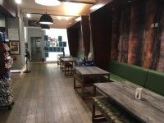
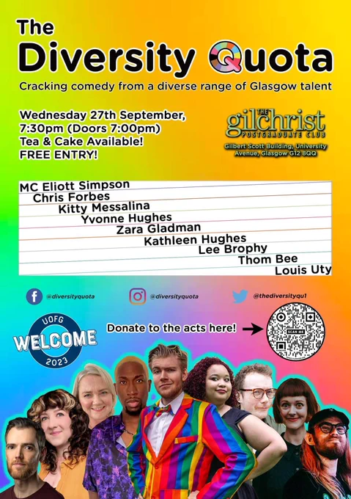
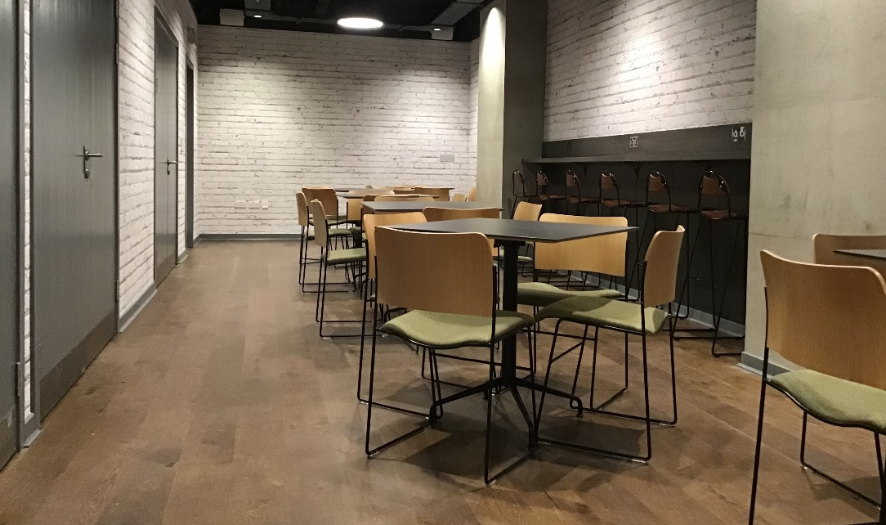
Gilchrist Postgraduate Club
Notes:
Space for PG students which serves coffee (and assorted hot/cold drinks!), food & alcohol
Wee G – bookable seminar room for PG students which is free to use and can host clubs & societies events!
Fully wheelchair accessible
Runs a series of events throughout the year like pub quizzes, drag, comedy, whisky tasting, knitting, etc!
Open to PGs hosting their own events or taking part!

Slide 7
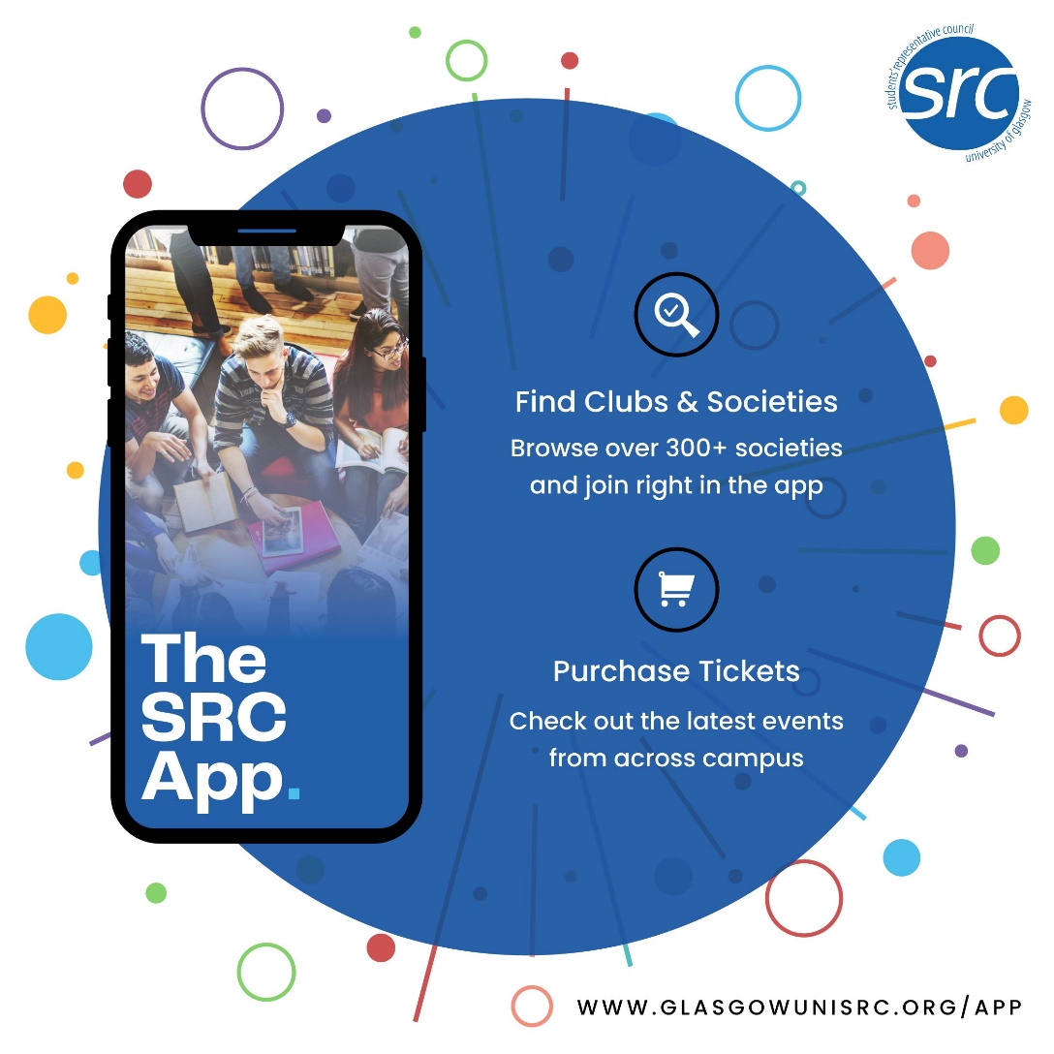
SOCIETIES
Notes:
We have over 300 student societies on campus – details for these can be found on the SRC app!
Societies can have a variety of purposes – some of the ones shown on screen are designed around specific degrees (e.g. Glasgow University Accounting Society), languages and cultures (e.g. Glasgow University German Society), or activities (e.g. Glasgow Student Dance Company). However, societies can be based on anything – for example, we also have a Taylor Swift Society on campus!
You can also start your own society if you have a particular passion which isn’t currently recognised on campus!
You can be as involved in societies as you like – being on a society board can look great on your CV, but you may also just want to make new friends and try something new!

Slide 8
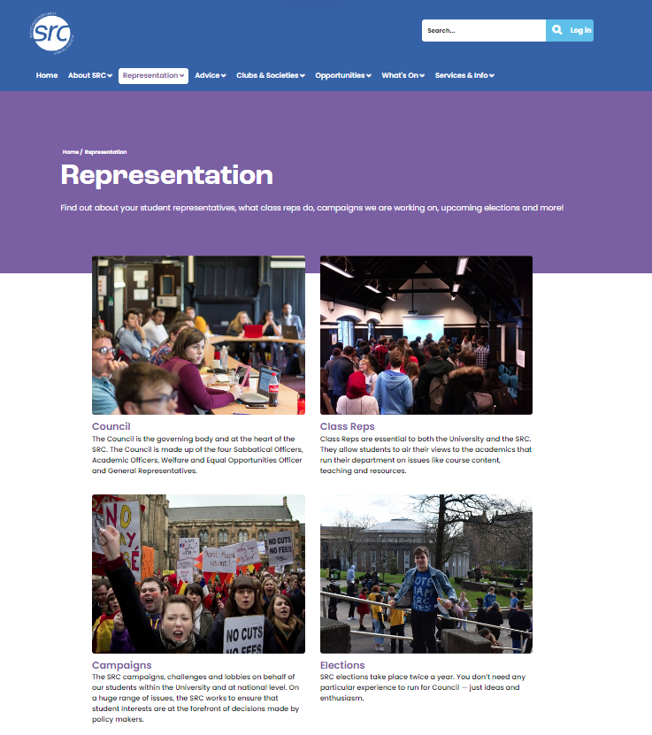
BECOME A CLASS/PGR REP
Represent your cohort
Learn more about how things work at the university
Have it on your transcript
Fight for the issues that matter
Notes:
Highlight that for PGRs, they are PGR reps who represent all the research students within their school or subject – even though they don’t have a class they can still be a rep!
Becoming a class rep is often a good way to start getting involved with the SRC – but what does being a class rep involve?
Class reps work closely with school reps to deliver feedback on key issues impacting students within their course. Feedback they give to school reps is then raised at school learning & teaching committees, or raised in meetings with the SRC’s VP Education
Class reps also attend staff-student liaison committee meetings, where they can give feedback gathered from their course directly to staff (this can be a good way of bringing about fast change, rather than having to wait until the end-of-year surveys to bring up any concerns!)
Being a class rep goes on your HEAR transcript, which acts as evidence of your role and can be useful when applying for jobs. It’s also a great way to work with new people and develop transferable skills. We also run class rep events throughout the year which can be a great way to make new friends from outside of your course!

Slide 9
COUNCIL ELECTIONS
Notes:
You can also run in our elections if you would like to be on Council! Elections take place twice a year, in March and October.
In our March Elections, our four sabbatical officers are elected for the next academic year, as well as academic reps and welfare & equal opportunities officers.
In our October Elections, any unfilled positions from March are up for election, as are general and first year representative positions and any postgraduate positions.
More information will be posted on our social media channels in the run up to elections, so stay tuned to find out more!

Slide 10
Contacts
Notes:
Follow us on our various social media channels for updates throughout the year!
You can also find contact details for your student representatives and our services on the SRC website.
On behalf of the SRC, best wishes for your studies and remember that we are always here to support you! ☺

